Slide 1

Analysis of Sales Orders
Examining the Effect of 2017 Hurricanes and Wildfires

Slide 2
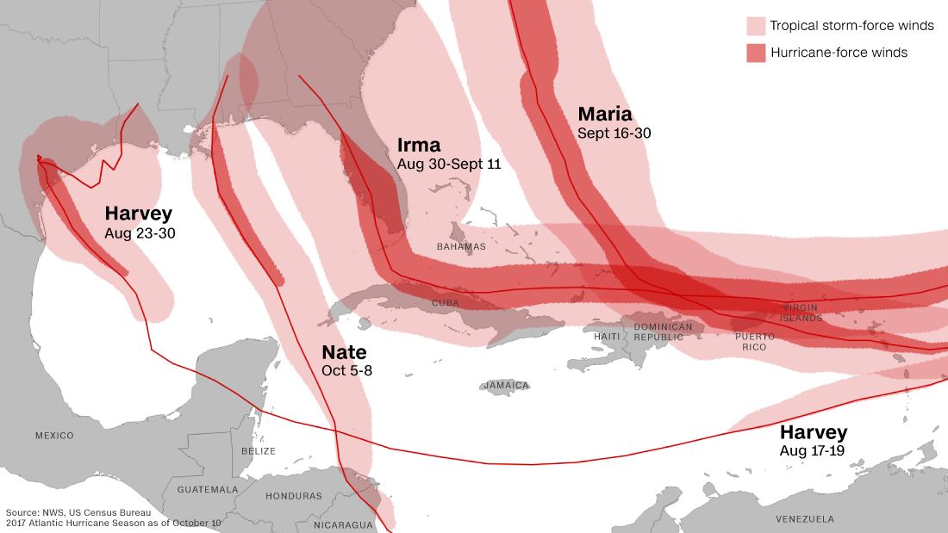
From August 2017 to December 2017 there were 209 registered wildfires of varying size in California according to the government of State of California. Reference: http://www.calfire.ca.gov/general/firemaps
Four major storms affected the Gulf and South East Regions of the United States beginning in the last week of August 2017 thru October 2017. Reference: www.cnn.com

Slide 3
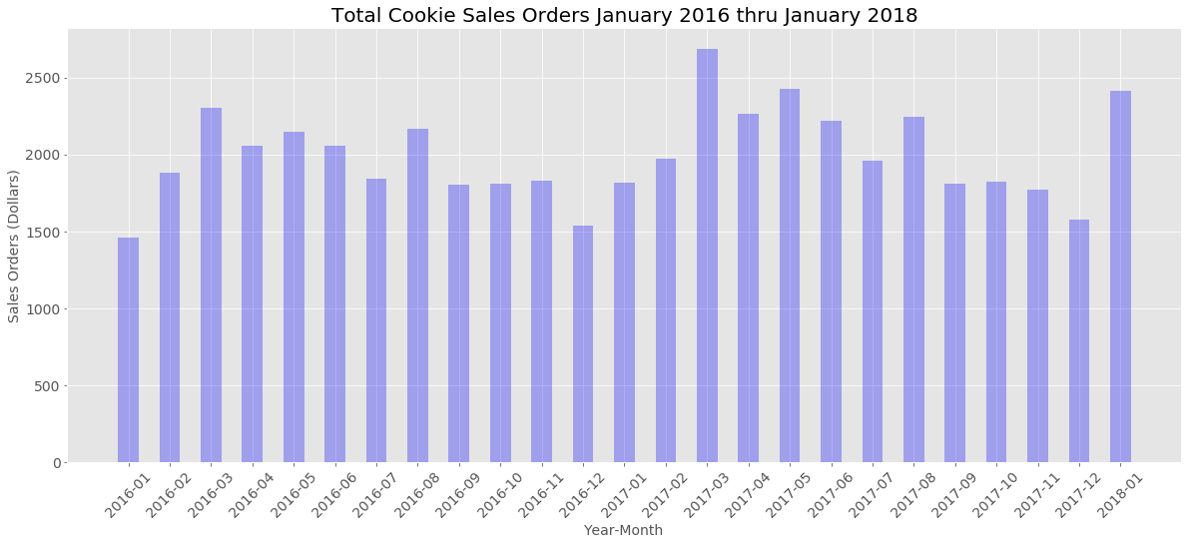
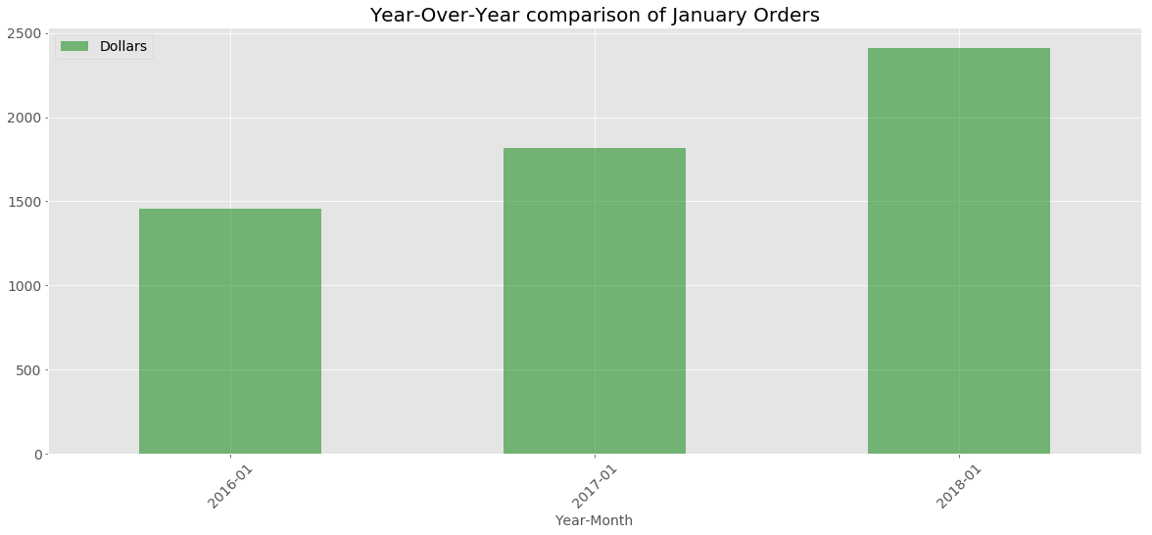

Slide 4
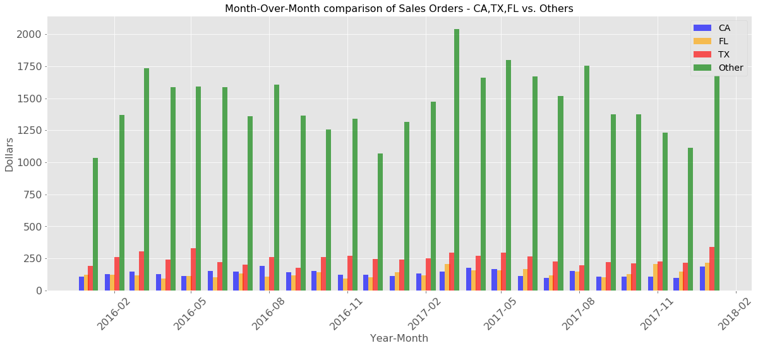
Examining Affected States vs. Other Sales

Slide 5
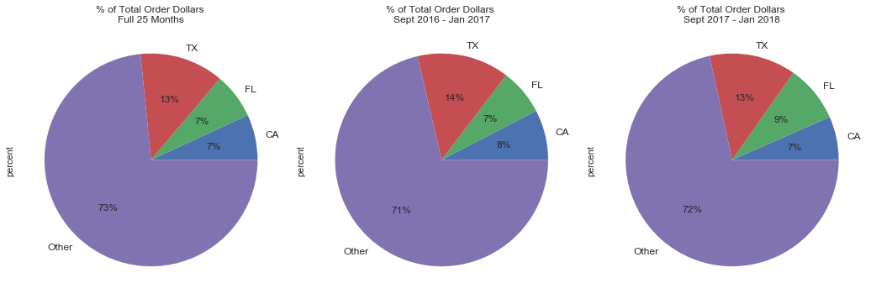
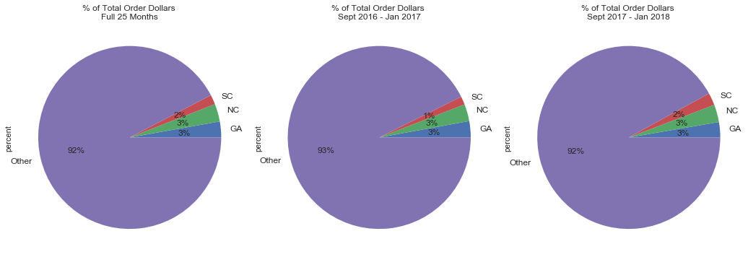
Percentage Comparisons

Slide 6
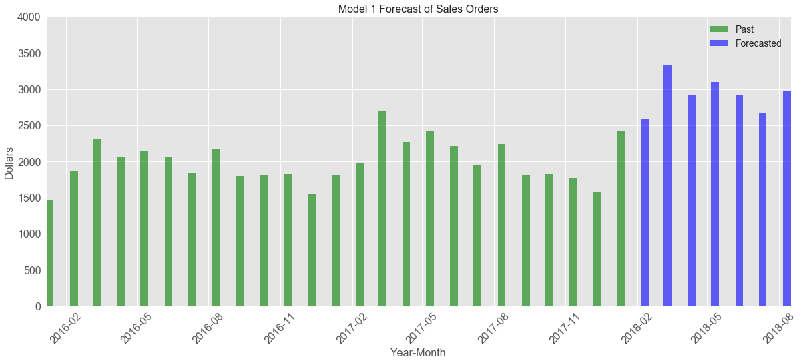
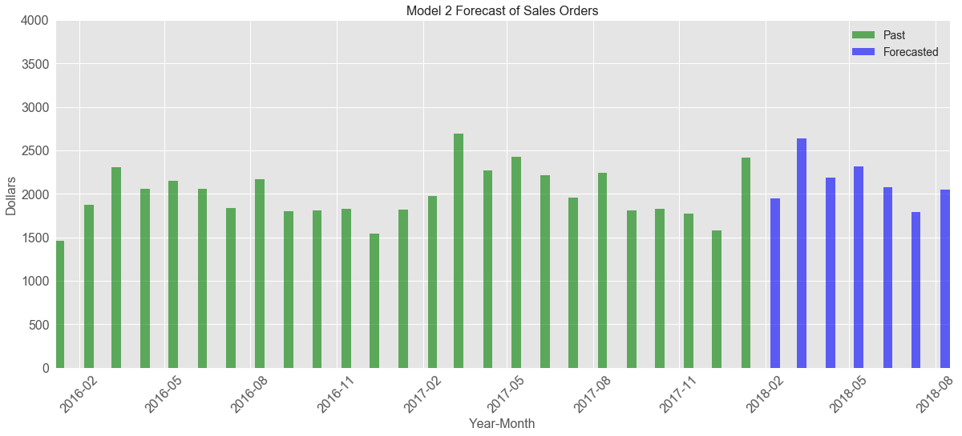
Forecast Models

